Slide 1
Rackspace - ToDo Manager
A few screenshots demonstrating
the use of the application have been presented here.
-Thenmozhi Singaravel

Slide 2
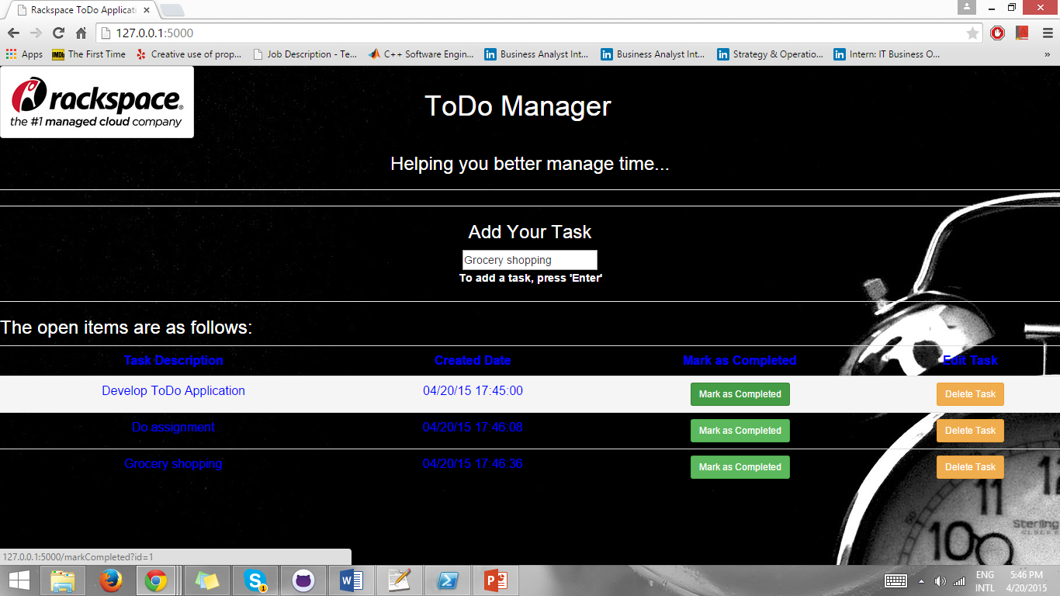
Adding tasks

Slide 3
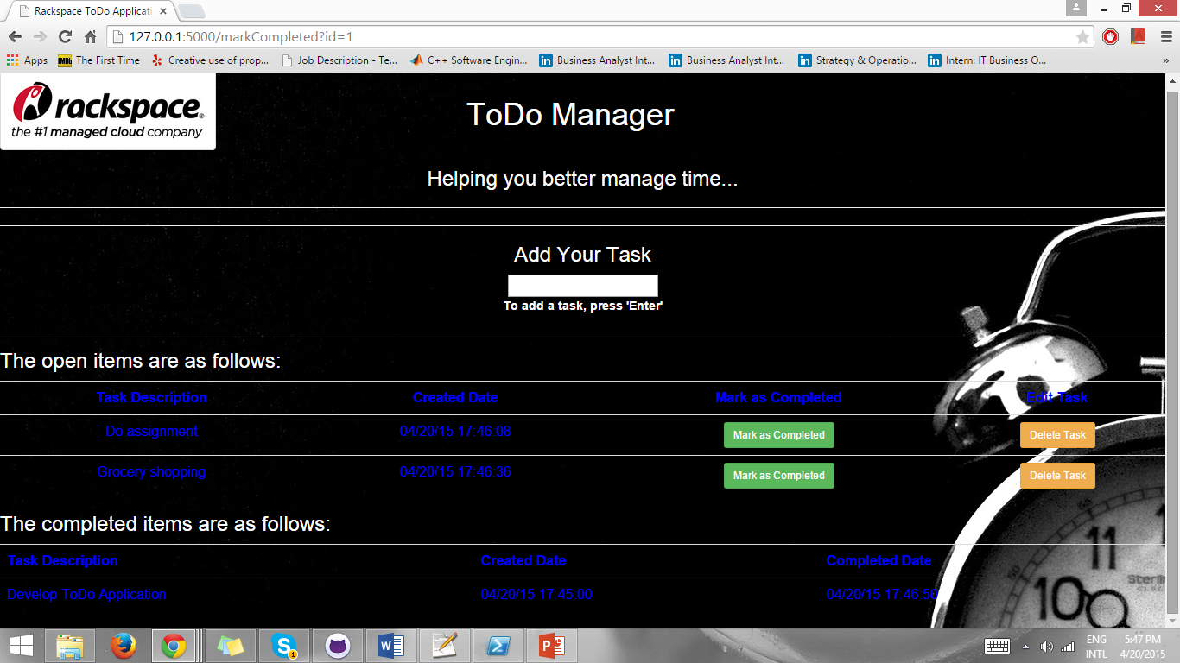
Marking a task as complete

Slide 4
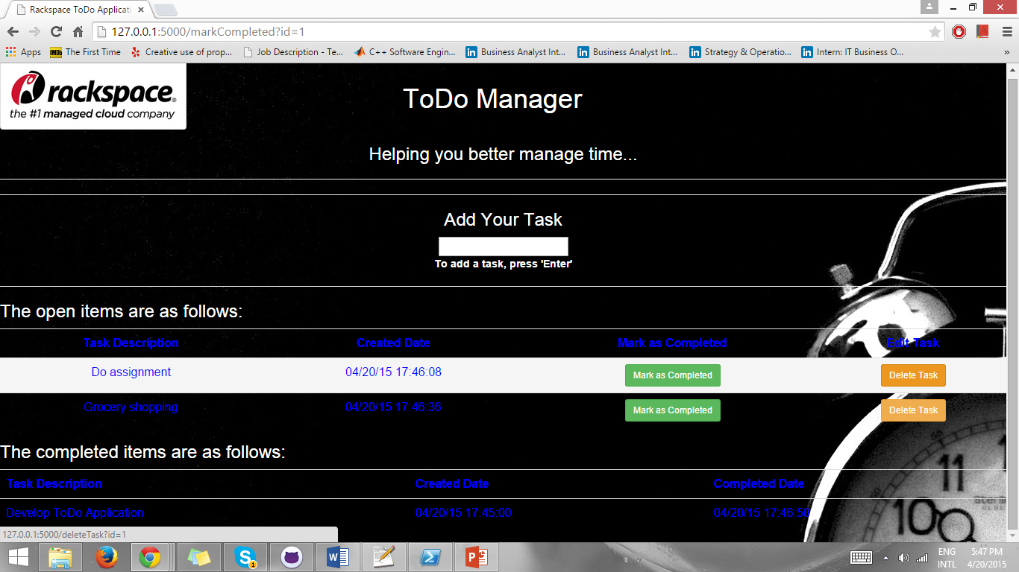
Deleting a task

Slide 5
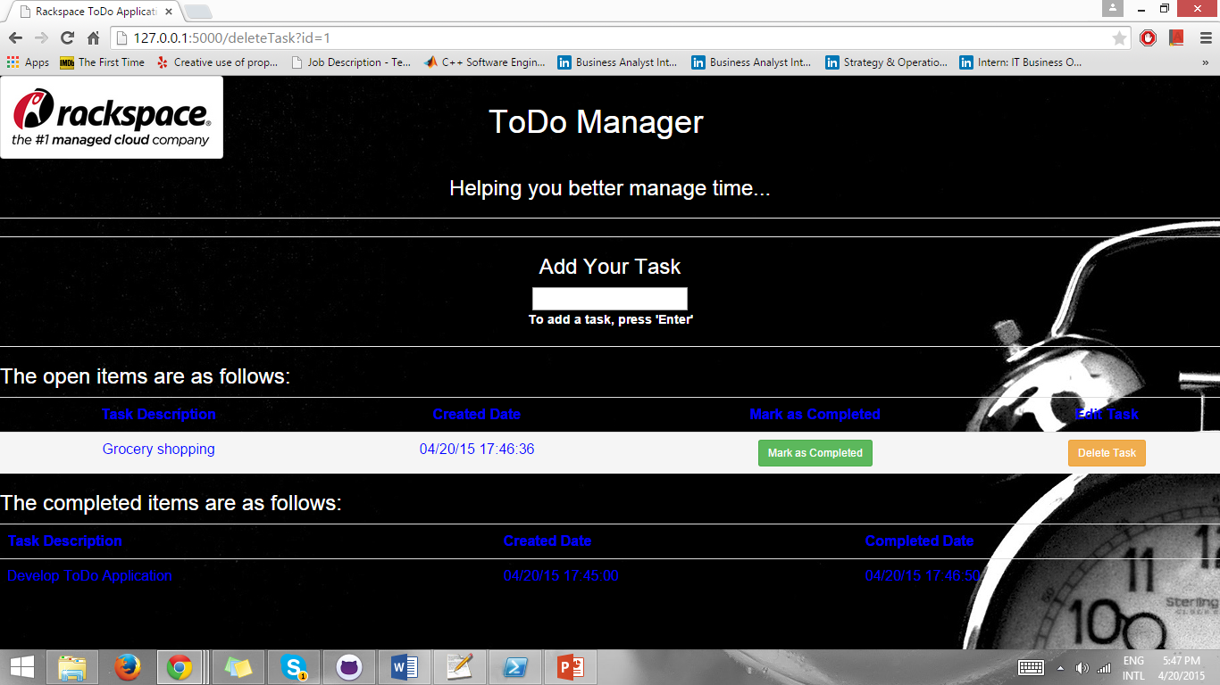
Deleted a particular task

Slide 6
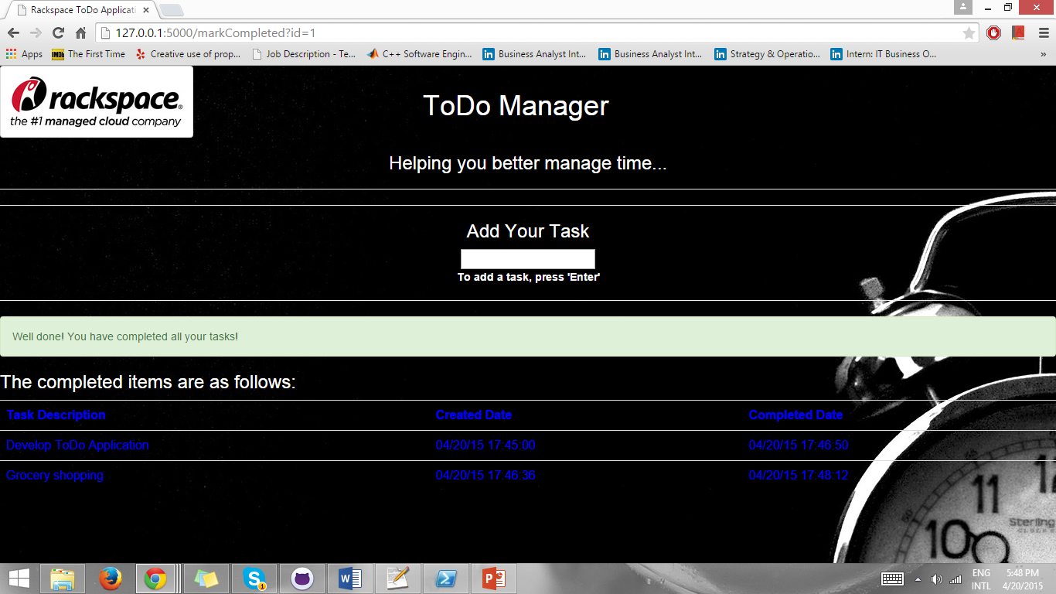
All tasks have been completed!

